Slide 1
Walt Disney
By: Adela Grahovac, pupil of the 6.b form

Slide 2
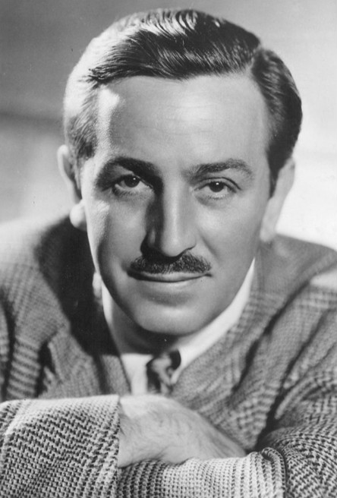
Biography
Walter Elias "Walt" Disney
5. of December 1901.
15. of December 1966.
Started a company with Ub Iwerks
Year 1934. – Snow White and the Seven Dwarfs
Year 1954. – his own TV-series
Year 1955. – “Disney” in California
Year 1971. – Walt Disney World Resort

Slide 3
The Walt Disney Company
Established 16. of October 1923.
Founders: Walt and Roy Disney
1930.-1986.
Subsdiaries
Film studios
Music studios
Distribution companies
Broadcasters

Slide 4
Walt Disney Pictures
Established 1983.
American production house
Family and children movies
Some of the films were: Pinokio,
Cinderella,Bambi, the Little mermaid

Slide 5
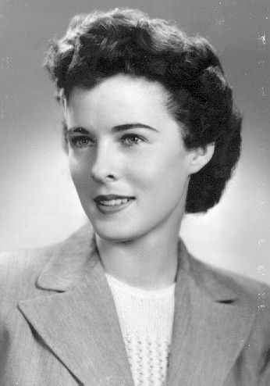
Lillian Disney
Walt Disney’s wife
15. of February 1899.
16. of December 1997.
Occupation
Wedding dress
Two daughters with Walt

Slide 6
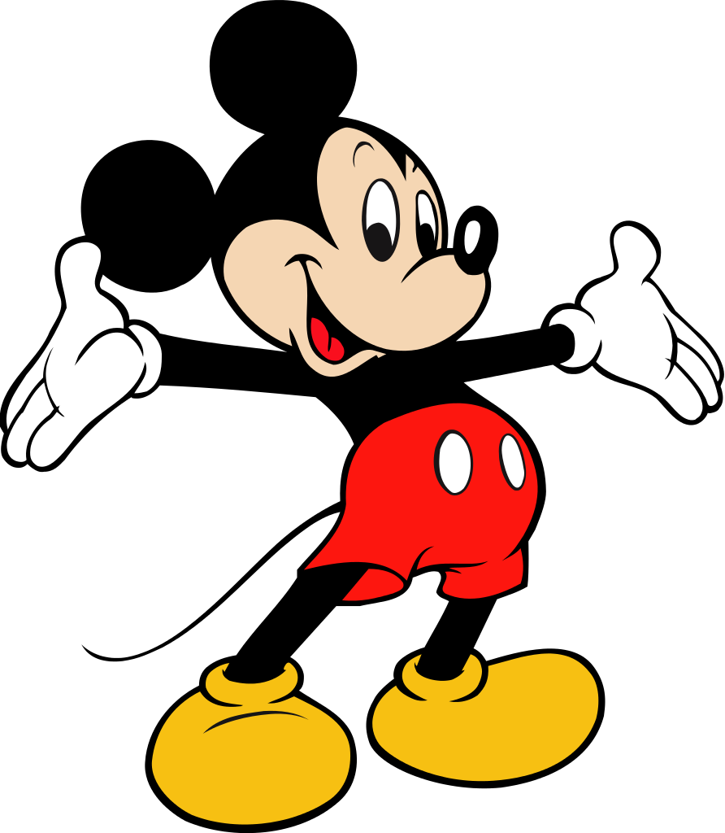
Mickey Mouse
Character
Disney’s ikon
Year 1982.
Jimmy MacDonald
Minnie Mouse
“The Mickey Mouse Clubhouse”

Slide 8
I HOPE YOU LIKED MY PRESENTATION!!!
Literature: https://bs.wikipedia.org/wiki/Po%C4%8Detna_strana

