Slide 1
Technology

Slide 2
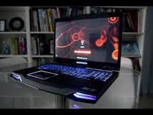
The technology is the use and knowledge of tools, techniques associates, the system and method of organization.
people began to use it to convert the rich natural resources into simple tools

Slide 3
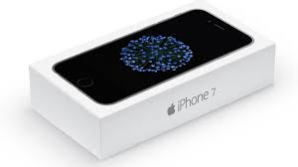
Technology began to affect people negatively and positively.

Slide 4
Technology has changed the way of life

Slide 5
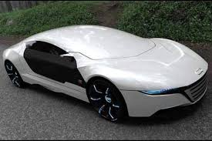
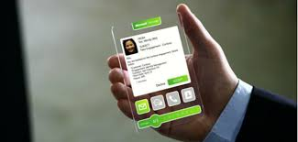
Here's how the future will look like in 50 years.

Slide 6
The end

