Slide 1
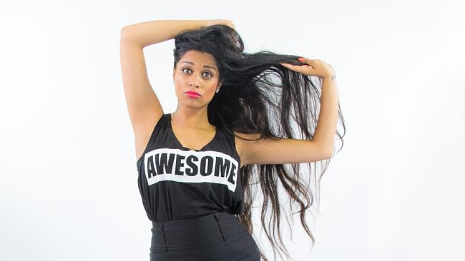
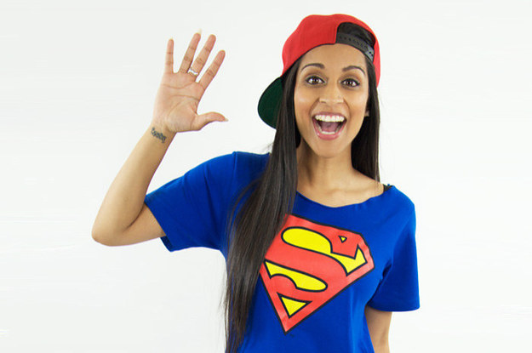
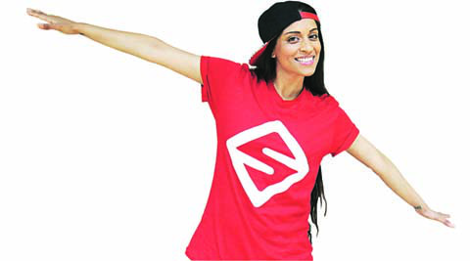
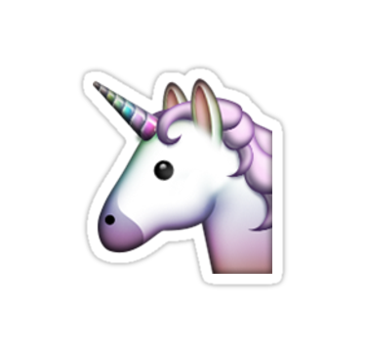
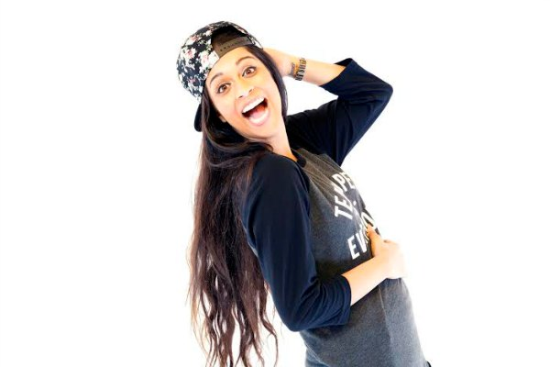
|| Superwoman ||

Slide 2
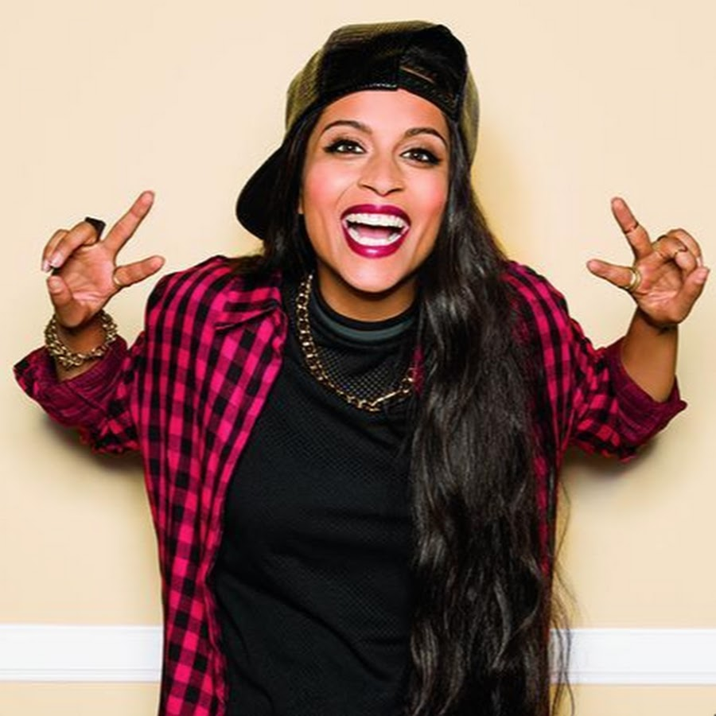
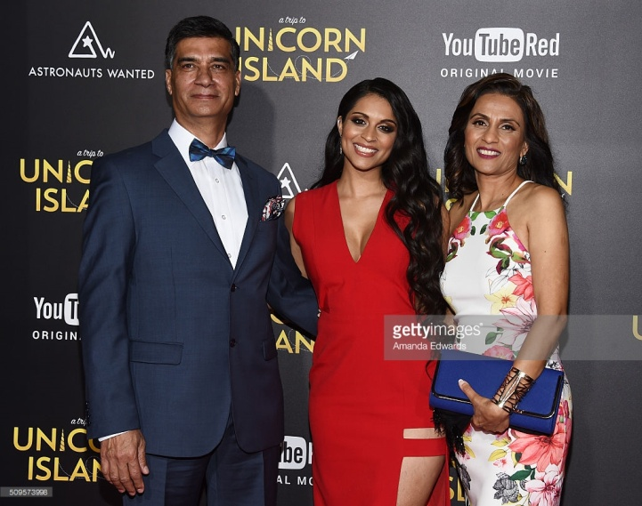
▫ Lilly Singh
Born on 26th September 1988 in Scarborough, Canada
Her parents are Malwinder and Sukhwinder Singh (from Punjab, India)
She graduatet Lester B. Pearson Collegiate Institute and New York University
Youtuber, actress, author,
motivational speaker, rapper and vlogger
Lives in Los Angeles, California

Slide 3
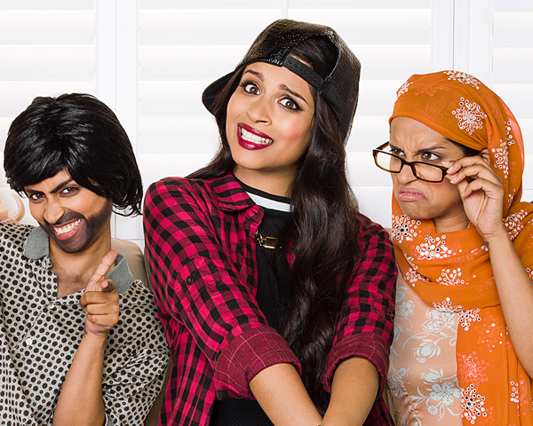
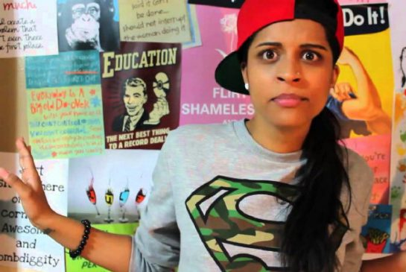
▫ Youtube carier
Started in October 2010
The name of channel is ||Superwoman||
She has 10 million subscribers
Vlogs, comedy, skits and motivation videos
Her most popular series are about her fictional parents
8th world´s highest paid YouTube star ($3 million in 2015)
in December 2011 she start with vloging

Slide 4
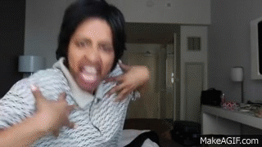
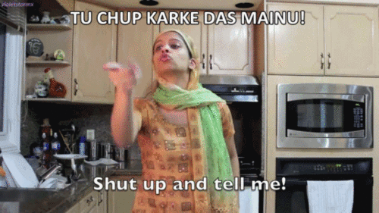
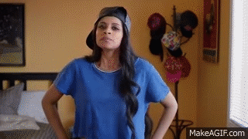
▫ Fictional parents

Slide 5
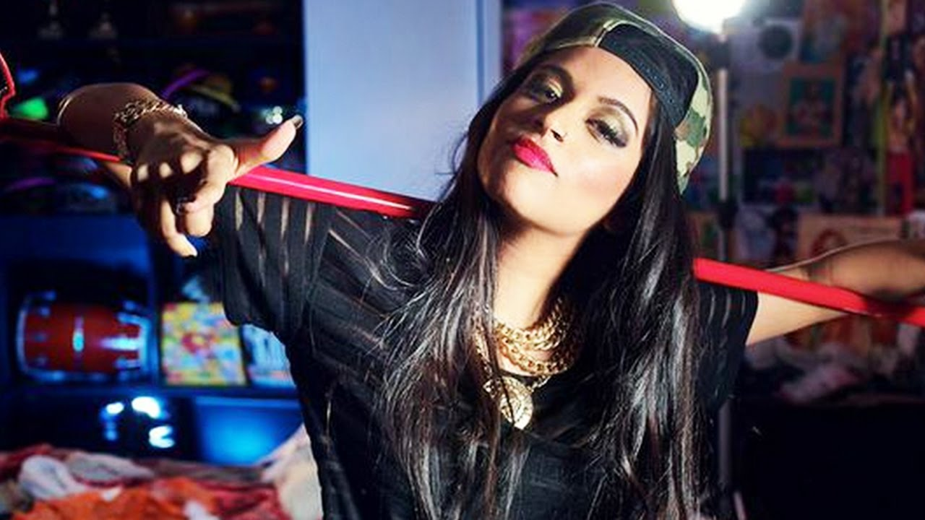
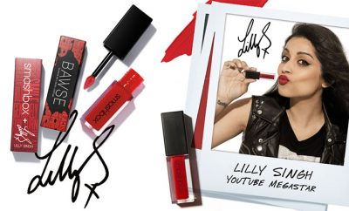
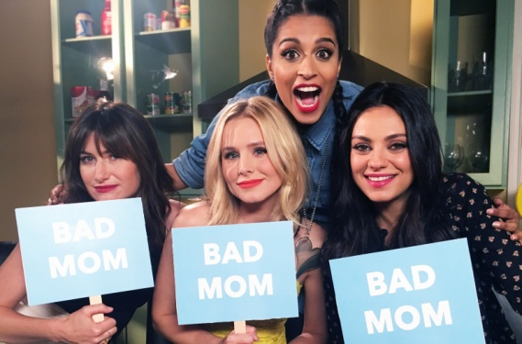
▫ Acting, rapping...
She voiced miniature unicorns named Bubbles and Misty in the animated film “Ice Age”
Played in the movie “Bad Moms”
Her songs are: Clean Up Anthem, Voices, #LEH...
Lilly has her new lipstick in collaboration with Smashbox Cosmetics named BAWSE

Slide 6
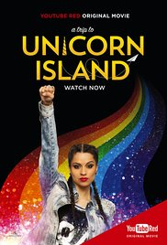
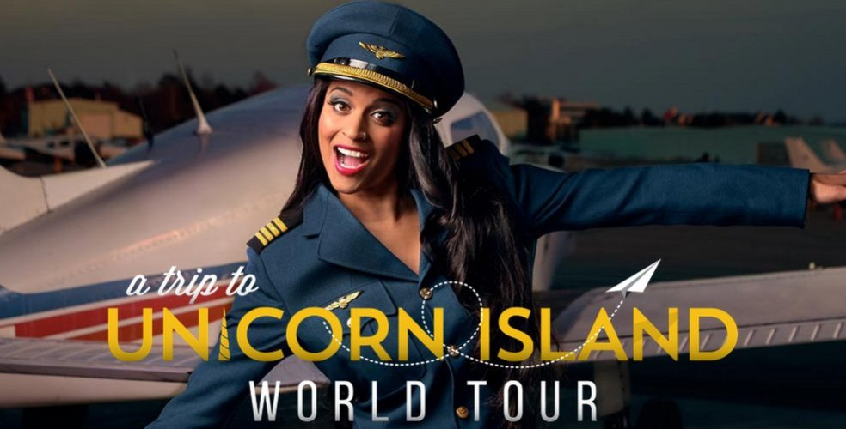
▫ A Trip to Unicorn Island
She had a world tour called “A Trip to Unicorn Island”
The movie was released on February 10th 2016 on YouTube Red
App named "Unicorn Island"

Slide 7
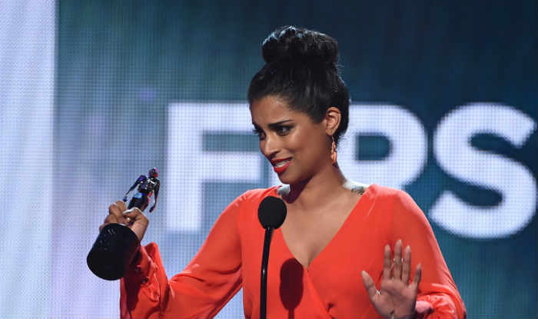
▫ Awards
Won awards for:-Social Superstar of the Year (MTV
Fandom Awards)
- First Person, A Trip to Unicorn Island, Social
Good Campaign (Girl Love Challenge) (Streamy
Awards)
-Choice Web Star: Comedy, Female (Teen Choice
Awards)

Slide 8
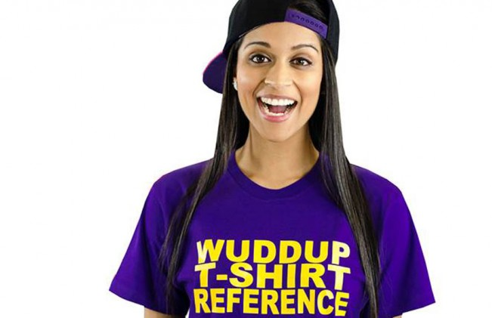
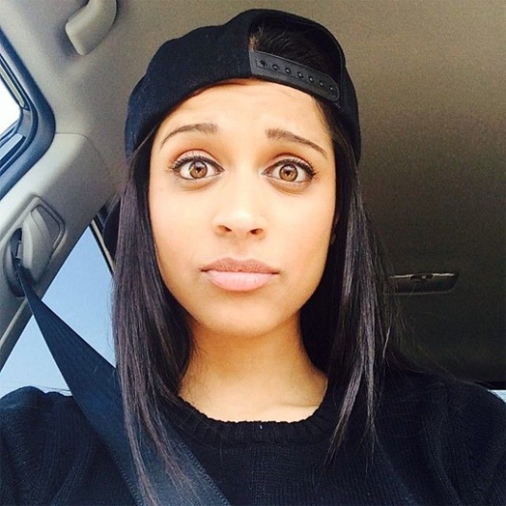
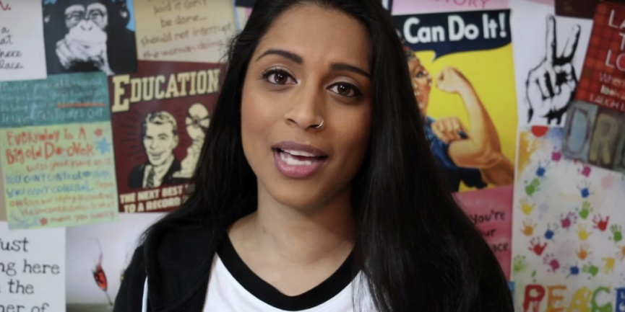
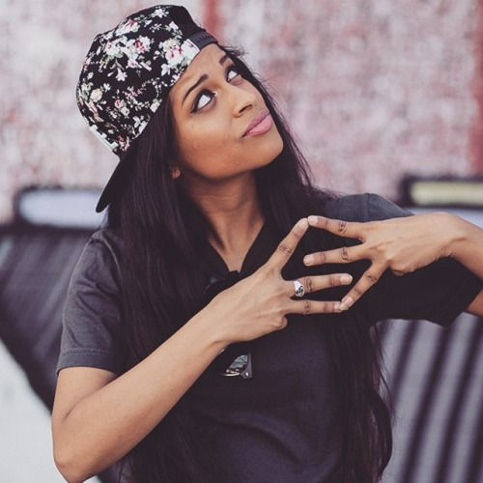
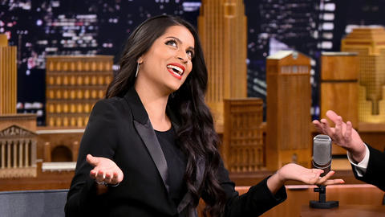

Slide 9
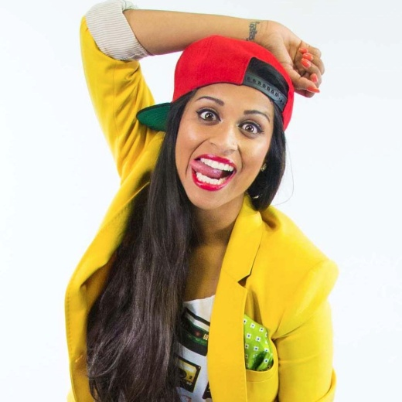
The End
Sara Bednaić, 7.b

