Slide 1
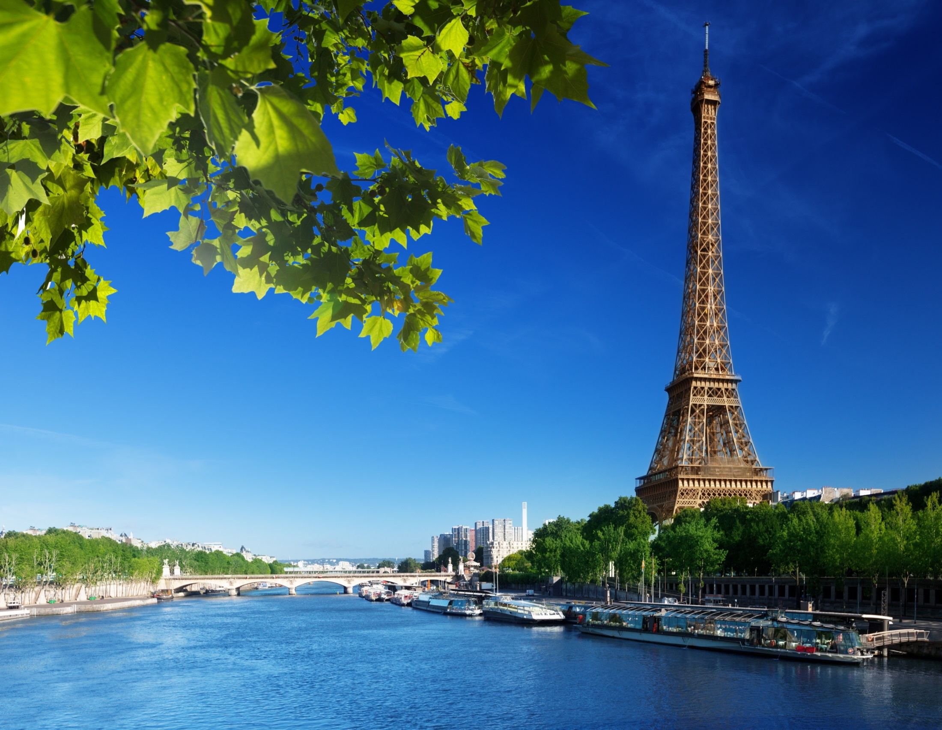
Eiffel tower

Slide 2
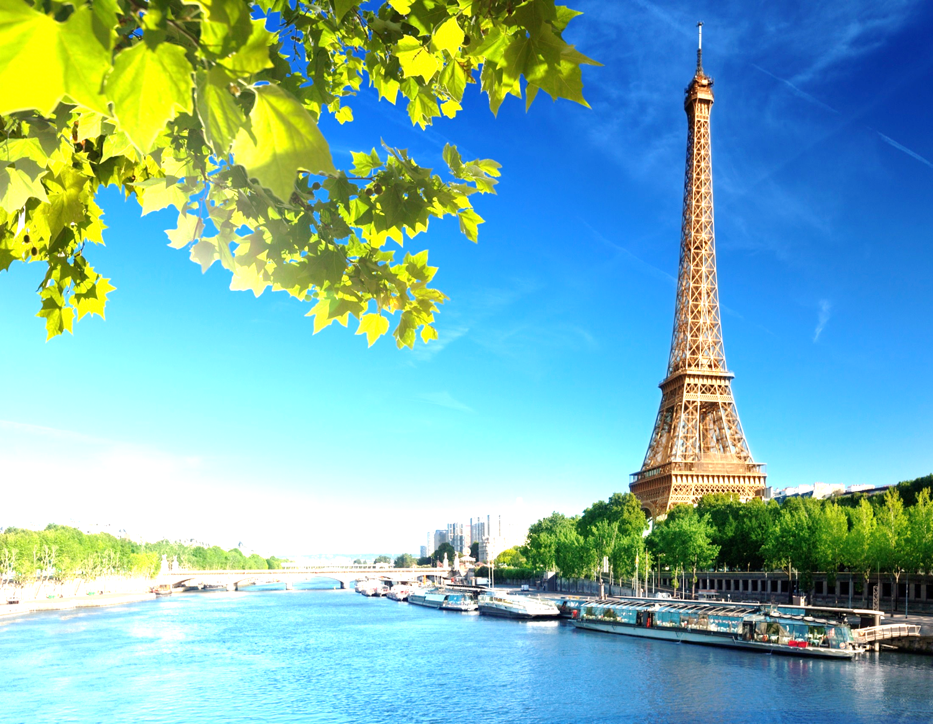
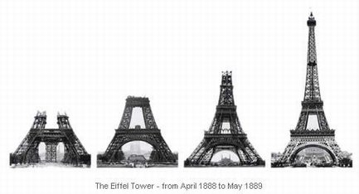
Tower is built betwen 1887 and 1889
It is in Paris
It is named after the engineer Gustave Eiffel

Slide 3
The tower is 324 metres tall
It is made of iron
It has 1665 stairs
It weighs 10 100 tons

Slide 4
The tallest structure in Paris
It has the shape of pyramid
One of the most famous structure in the world

