Slide 1
Dream Theater

Slide 2
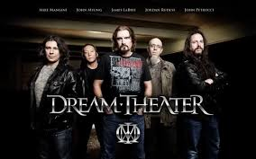

Slide 3
- American progressive metal band formed in 1985
- one of the most famous bands in the world

Slide 4
4
band members: John Myung, Jordan Rudess, James LaBrie, Mike Mangini and John Petrucci
they are all great musicians because they studied music at Boston Music Academy
Notes:
444444444444

Slide 5
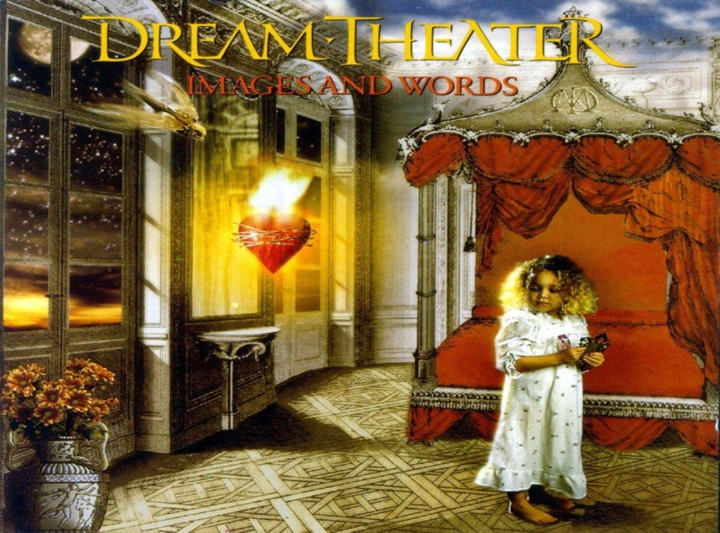
- the best-selling album: The Images and Words

Slide 6
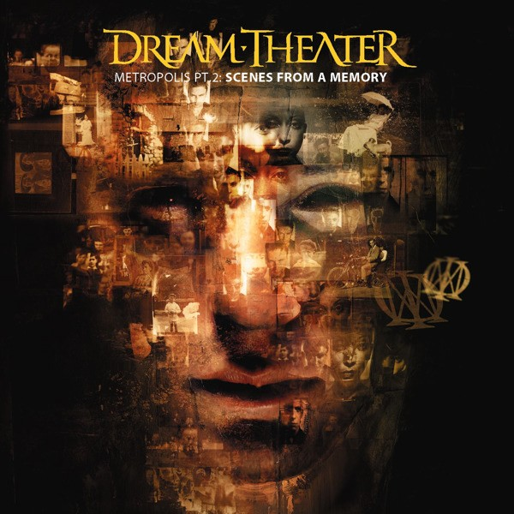
my favourite album is Scenes from a Memory

Slide 7
Thank you for your attention!
☺

